Slide 1
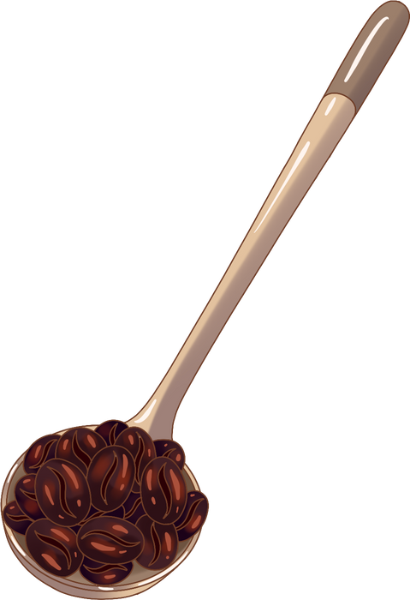



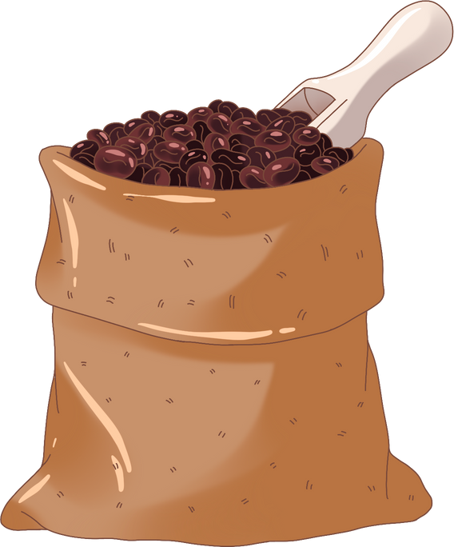

COFFEE WITH THE
COUNSELORS
Presented by
KHS Counselors
September 17, 2025

Slide 2
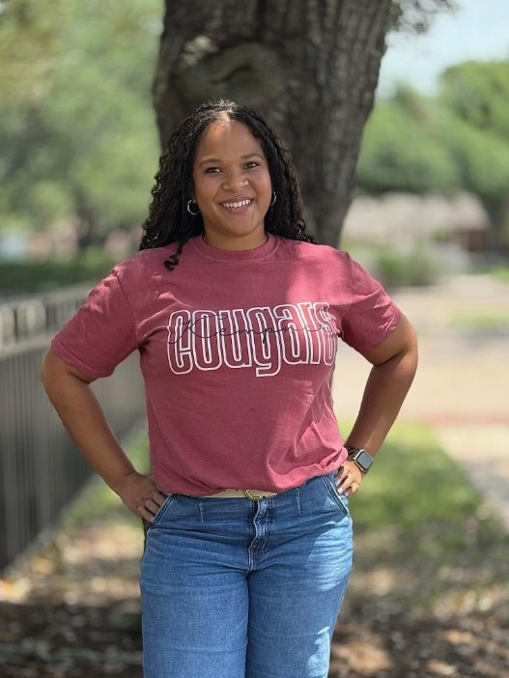
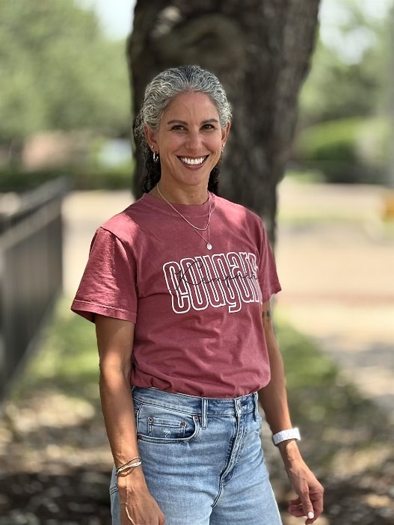
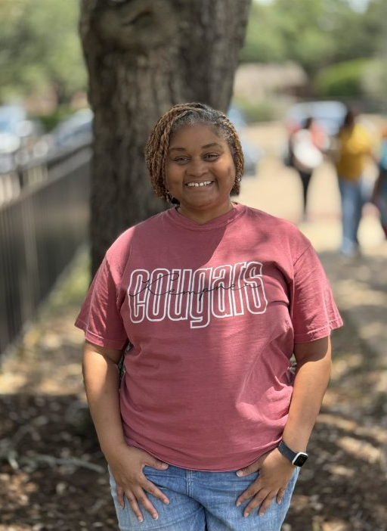
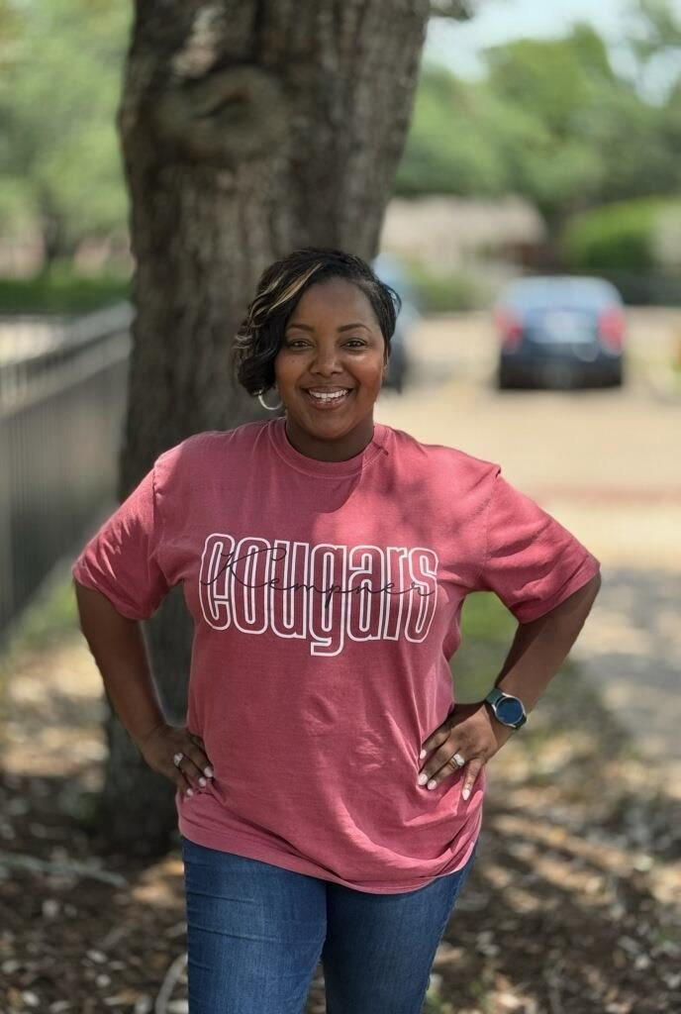
Introduction
Ms. Thomas- Lead
SN- Z & Academies
Ms. Cardwell
A - GE
Ms. Durgens
GH - MOM
Ms. Burrell
MON - SM
SCHOOL COUNSELORS

Slide 3
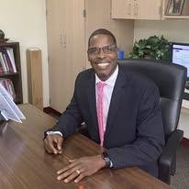
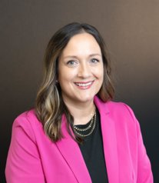
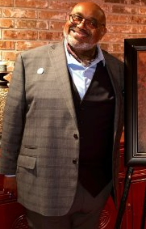
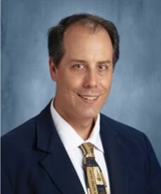
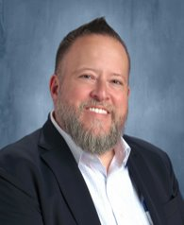
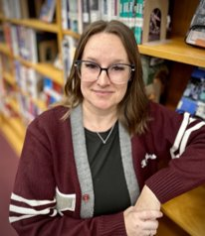
KHS ADMINISTRATORS
Dr. Brown
Principal
Ms. Montelongo
Associate Principal
Mr. Jedkins
9th Grade
Assistant Principal
Mr. McCabe
10th Grade
Assistant Principal
Mr. Maldonado
11th Grade
Assistant Principal
Ms. Squires
12th Grade
Assistant Principal

Slide 4

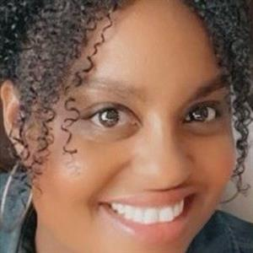
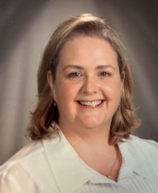


Ms. Hines
College Career Readiness Advisor
Ms. LaValley
Campus Assessment Coordinator/Dean

Slide 5

What we do…
High school counselors serve as advocates, educators, and guides for students. They help students succeed academically, socially, and emotionally while preparing them for postsecondary education and careers. Counselors also collaborate with teachers, administrators, and families to create a supportive school environment.
1. Academic Development
2. Social-Emotional Support
Guide students in course selection to meet graduation requirements.
Monitor academic progress and intervene when students are struggling.
Coordinate level changes, schedule adjustments, and academic support.
Teach students organizational, study, and time-management skills.
Provide short-term, solution-focused counseling for personal, social, or emotional concerns.
Support students in crisis situations (grief, conflict, mental health challenges).
Refer students and families to outside resources for long-term counseling or specialized support.
Teach coping strategies, conflict resolution, and resilience skills.

Slide 6

What we do continued…
3. Personal & Social Development
4. Administrative & Other Responsibilities
  Promote inclusivity, equity, and a positive school climate.
  Address bullying, harassment, or behavior issues through mediation and restorative practices.
  Build relationships through visibility
  Foster social skills and self-advocacy in students
  Maintain student records and documentation (transcripts, credits, testing).
  Track graduation rates, testing results, and CCMR indicators.
  Partner with teachers to support students’ academic and behavioral needs.
  Communicate with parents/guardians regarding progress, concerns, and resources.
  Collaborate with administrators on student services, discipline alternatives, and policy.

Slide 7


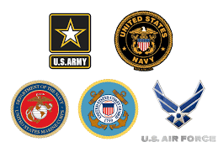
College Career Military Readiness
College, Career, and Military Readiness (CCMR)
Provide information on college admissions, vocational programs, apprenticeships, and military options.
Assist with applications, essays, scholarships, and financial aid (FAFSA/TASFA).
Host college/career fairs, campus visits, and guest speaker sessions.
Help students develop personal graduation plans and career pathways.

Slide 8
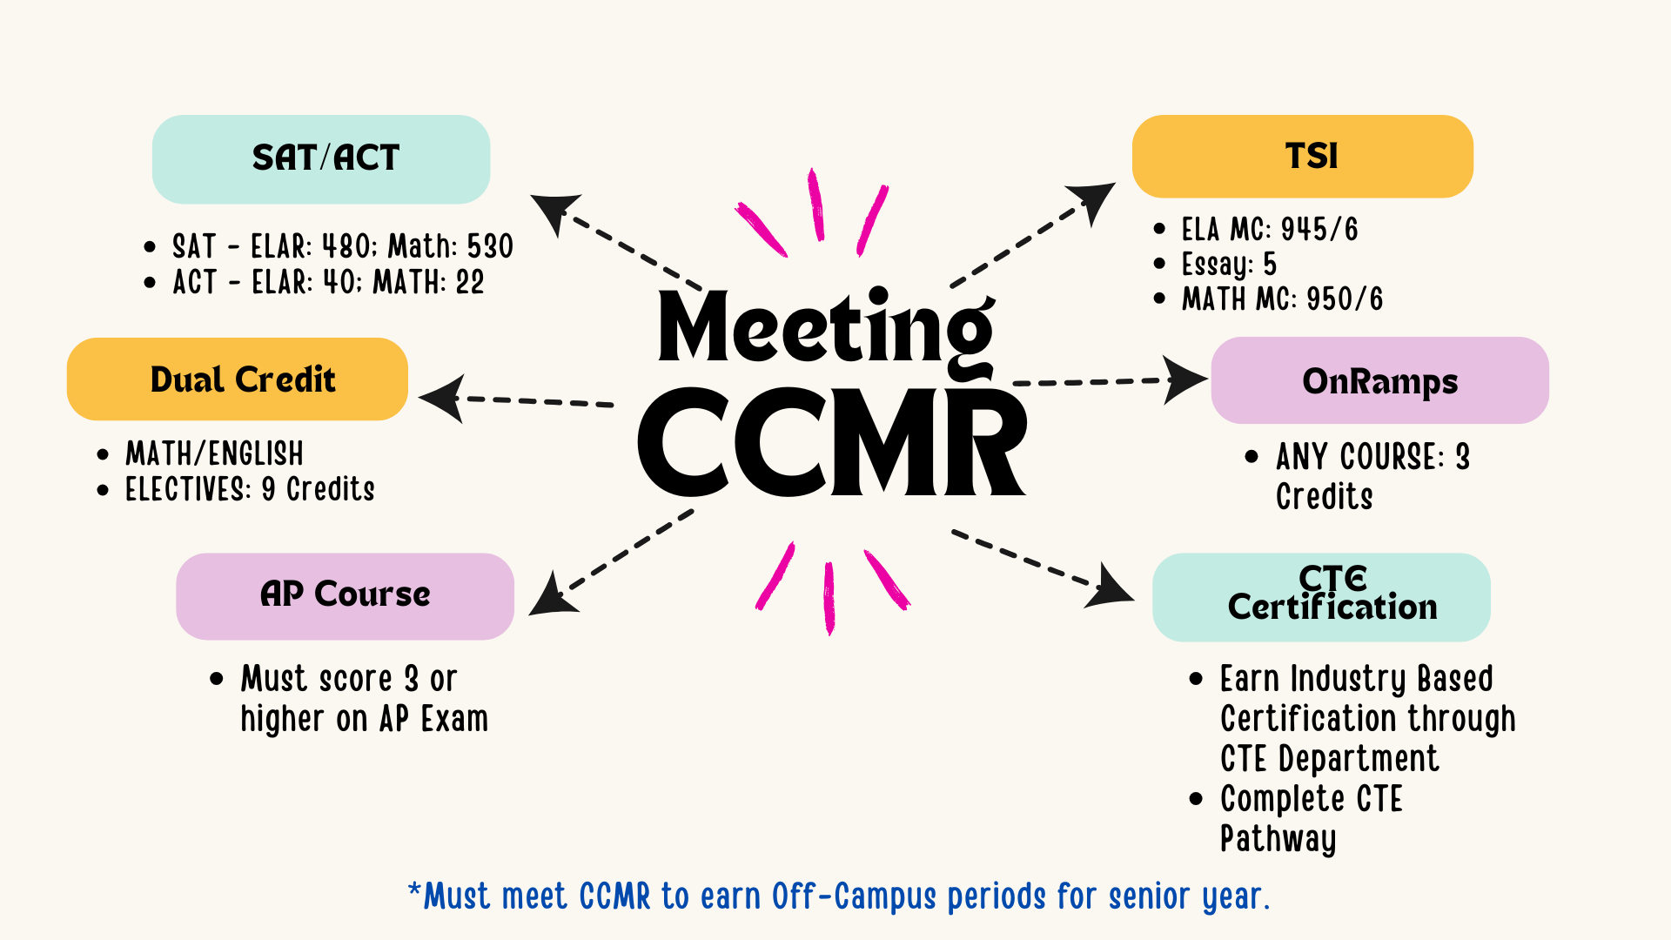
College Career Military Readiness

Slide 9



Testing And Compliance
There are five STAAR EOC that students must pass to graduate.
English I in 9th grade
Biology in 9th grade
Algebra I in 9th grade
English II in 10th grade
US History in 11th grade
April 7th
April 21st
April 16th
April 9th
April 14th
If students do not pass or are absent for the Spring administration, they will have an opportunity to retest in June and again in December the following year.
**Students will continue to re-test until they pass.

Slide 10
Q & A

Slide 11
THANK YOU

